Slide 1
Welcome! We’ll begin in prayer.

Slide 2
Agenda for week 2: The Chosen discussion group
Welcome & Opening Prayer
What to Expect? Agenda & Housekeeping
Introductions & Opening Question
Small Group Discussions in Breakout Rooms
Closing Prayer

Slide 3
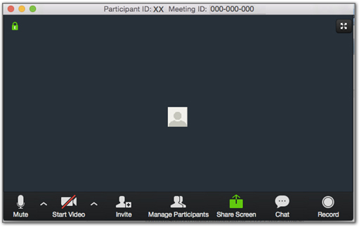
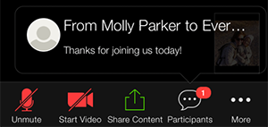
Housekeeping (the zoom equivalent of, “let me show you where the restrooms are”)
Have a question?
Chuck Priestap is available for tech support & general Q&A.
Use the “Chat” feature to reach Chuck, Lisa, or Jessie
Notes:
If we were in person, we should show each other where the restrooms are. Over Zoom, there are things we can show each other to help each other feel comfortable, too. If you need any technical support, you can use the Chat feature to chat with Jessie or Chuck.

Slide 4
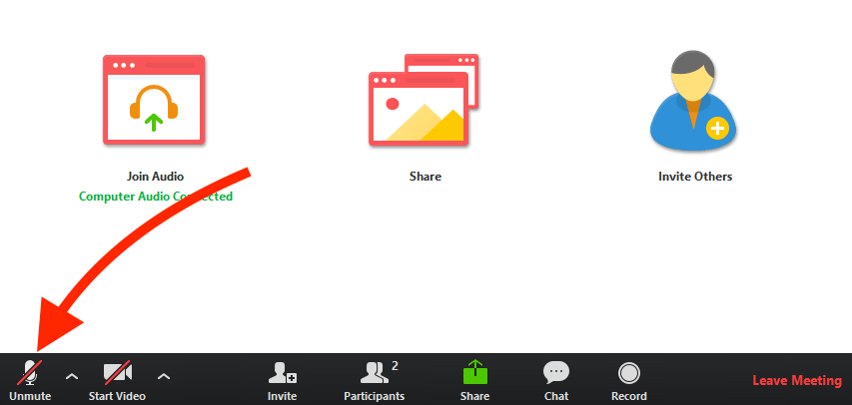
Zoom etiquette for today’s session & beyond
& please multitask mindfully!
“Whenever we see your smiling face…”
Mute unless you’re speaking
Use “Reactions,” and speak up!
Notes:
There are other norms we have that help Zoom meetings run smoothly and minimize awkwardness or misunderstanding.
Mute unless you’re speaking! We want to hear from everyone, but if all microphones are on at the same time, it creates audio feedback.
Please turn on your video if you’re able and willing. It helps build community when we can see one another’s facial expressions.
It also helps to use the Reactions feature on Zoom to express nonverbal cues that we’d normally see in-person. Take advantage of these!
Lastly, multitask mindfully. We know everyone has a different comfort level with different aspects of Zoom; maybe you like using all of the features, or maybe you find it distracting. Use what works for you. And, please stay focused and present to this conversation, even though it may be tempting to multitask on unrelated things during our time together.

Slide 5
what should I expect each week? Come and see…
You bring the loaves…
Watch that week’s show & review the discussion questions before the Wednesday discussion
Contemplate the content. Let it wash over you. Ask God what God wants you to share in the discussion.
Be prepared to listen deeply
And we’ll bring the fish…
We’ll email you the Zoom link by Monday with some sample discussion questions.
We’ll provide tech support!
We’ll facilitate discussion, be timekeepers, and invite you to share in ownership of the experience
WE TRUST GOD WILL DO THE REST!

Slide 6
Closing announcements
Watch
Watch Episode 3 by Wednesday of next week & do your prep reflection
Engage
Check your email on Monday next week for discussion questions and meeting link
Pray
Pray for each other in this community!

